Slide 1






How Much of My Dataset Did You Use? Quantitative Data Usage Inference in Machine Learning
Yao TONG
Jiayuan YE
Sajjad ZARIFZADEH
Reza SHOKRI
Data Privacy and Trustworthy Machine Learning Research Lab
Notes:
We are going to talk about
If I have a dataset, how can I tell how much of my dataset you used in your model’s training set?
advisor
zah-REEF-zah-’deh

Slide 2
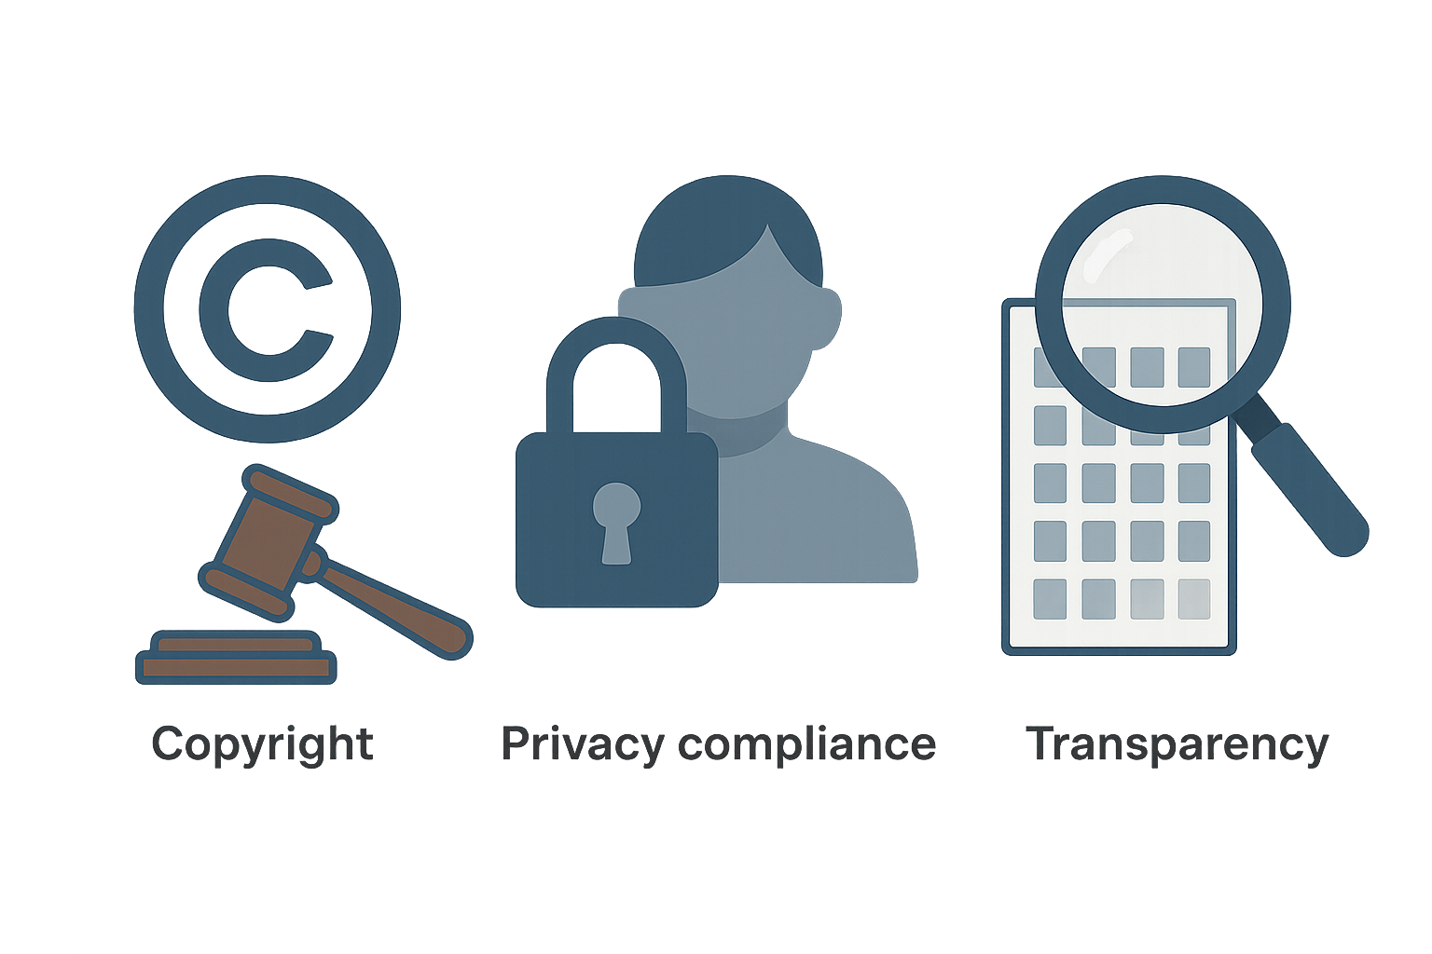
People care about dataset usage because ...
Copyright
Privacy
Transparency
Notes:
- People care about dataset usage for many reasons.
- For exmaple, copyright. If a model is trained on someone’s creative work without permission, that’s a serious issue. We’re already seeing lawsuits — like the one from The New York Times against OpenAI — claiming their articles were used without consent. It’s not just about money, but about who gets to control how their content is used.
- Privacy is also a big deal. If a dataset includes sensitive information, such as names, addresses, private messages, people definitely don’t want that turned into part of a model. Because models can leak.
- Third, transparency. People want to know what went into these models. Are there sources of bias? Was the data scraped responsibly? Beyond that, many places now have legal requirements for data transparency

Slide 3
The problem of dataset usage inference
Improperly defined as a binary problem in the existing literature
Goal: To infer whether the entire dataset was used or not used at all (i.e., all-or-none)
Notes:
There’s a large body of literature on the dataset usage problem, but most existing approaches—whether explicitly stated or not—are designed to give binary decisions They usually compute ...
However, Dataset usage is not all-or-nothing. In practice, people usually use parts of datasets, not the whole thing. So instead of a yes-or-no answer, we need to know **how much** was used — that’s what really matters.

Slide 4
The problem of dataset usage inference
Improperly defined as a binary problem in the existing literature
Goal: To infer whether the entire dataset was used or not used at all (i.e., all-or-none)
Existing Approach:
Compute “average” membership statistics over a dataset:
Raw data (Maini et al., 2021; Song & Shmatikov, 2019 ...)
Modified data (e.g., backdoor watermarking) (Wei et al., 2024; Li et al., 2023; Tang et al., 2023 ...)
Compare against a threshold (estimated from population data)
Notes:
There’s a large body of literature on the dataset usage problem, but most existing approaches—whether explicitly stated or not—are designed to give binary decisions They usually compute ...
However, Dataset usage is not all-or-nothing. In practice, people usually use parts of datasets, not the whole thing. So instead of a yes-or-no answer, we need to know **how much** was used — that’s what really matters.

Slide 5




Copyright infringement or fair use
“Amount and substantiality of the portion used in relation to the copyrighted work as a whole”
“Nature of the copyrighted work”
Section 107 of the U.S. Copyright Act (United States Code, 1976)
A factual work
20%
5%
Notes:
And this isn’t just theory.
For example, according to the U.S. Copyright Act, the portion used — along with the nature of the copyrighted work — plays a key role in deciding whether something counts as fair use or infringement.

Slide 6
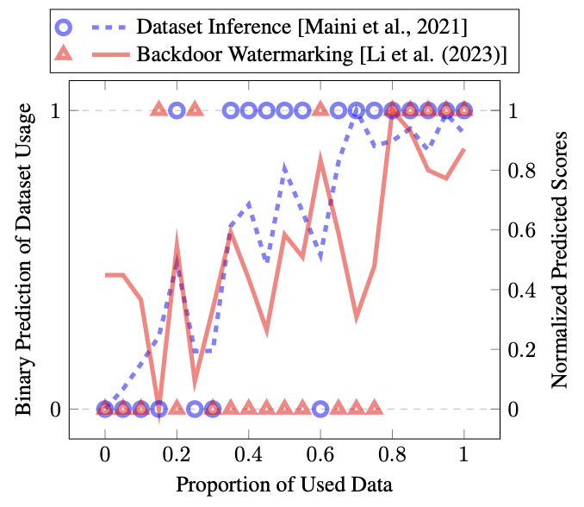
Solving the binary problem is unreliable!
Low error when predicting binary utilization (either none or all)
Notes:
Solving this binary problem is not actually solving the dataset usage inference problem, and is unreliable.
Prior works can perfectly predict the 0-1 binary utilization, but they appear to be fragile under the partial utilization.

Slide 7
Solving the binary problem is unreliable!
Low error when predicting binary utilization (either none or all)
Miss small proportion of usage
Notes:
We next show that solving this binary problem is not actually solving the dataset usage inference problem, and is unreliable.
Prior works can perfectly predict the 0-1 binary utilization, but they appear to be fragile under the partial utilization.

Slide 8
Solving the binary problem is unreliable!
Low error when predicting binary utilization (either none or all)
Miss small proportion of usage
Classify a model as
“utilizing” the dataset at one proportion,
“not utilizing” the dataset when usage increases
Such predictions are hard to trust in practice!
Notes:
- Tend to neglect small proportion of usage. - And within certain small change of used proportion, we can see huge fluctuation in prediction: they sometimes say “use” sometimes say “not use”.
- This instability makes their predictions difficult to trust in practice.

Slide 9
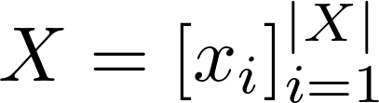
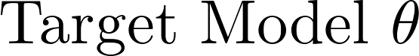

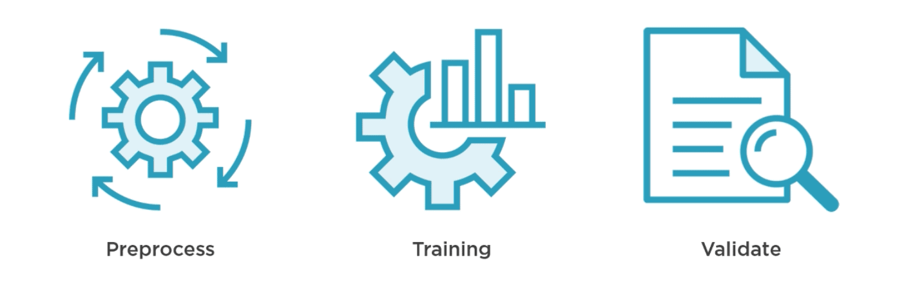
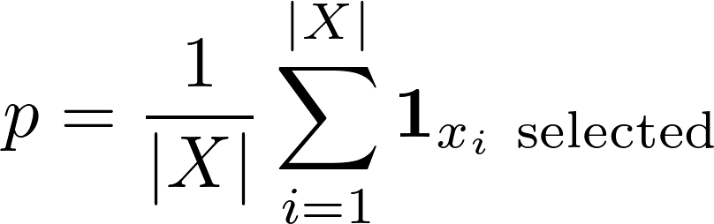
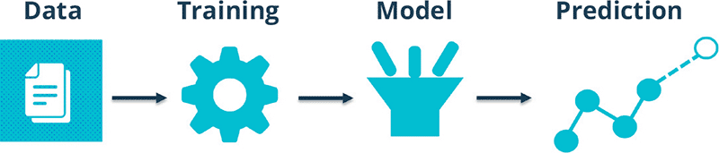
Dataset Usage Cardinality Inference (DUCI) problem
Given a model $θ$ and a target dataset $X$,
what fraction of the target dataset is used in training the model?
Notes:
- So what is the right problem we should work on if we want to get a reliable dataset usage inference?
- In this work, we formulate the Dataset Usage Cardinality Inference (DUCI) problem, using the proportion of a dataset used as a key signal. Formally, an adversary selects a proportion p of the target dataset to train a model using a training algorithm. Since the adversary may also use data from other sources, we model this by introducing a population pool within the training algorithm, from which additional data can be sampled.

Slide 10
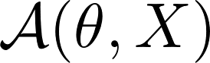

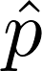
Dataset Usage Cardinality Inference (DUCI) problem
Given a model $θ$ and a target dataset $X$,
what fraction of the target dataset is used in training the model?
Query
Notes:
As an insepctor (or dataset owner), we only have query [question + ry] access to the target model, and knowledge of our own dataset and the training algorithm

Slide 11
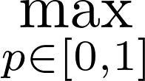
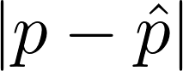
Evaluation Metrics
Maximum mean absolute error (MAE) across all data usage proportions
Notes:
To evaluate, we measure how far our prediction is from the true usage proportion, in the worst case over all possible p,

Slide 12
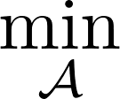
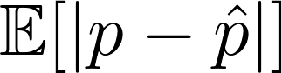
Evaluation Metrics
Maximum mean absolute error (MAE) across all data usage proportions
Notes:
Since even under the same p, the subset selection can vary across trials, we take the expectation to capture this randomness. (which then leads to the maximum mean absolute error). Our goal is to develop an algorithm to minimize this whole term.

Slide 13
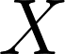
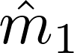
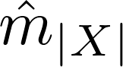
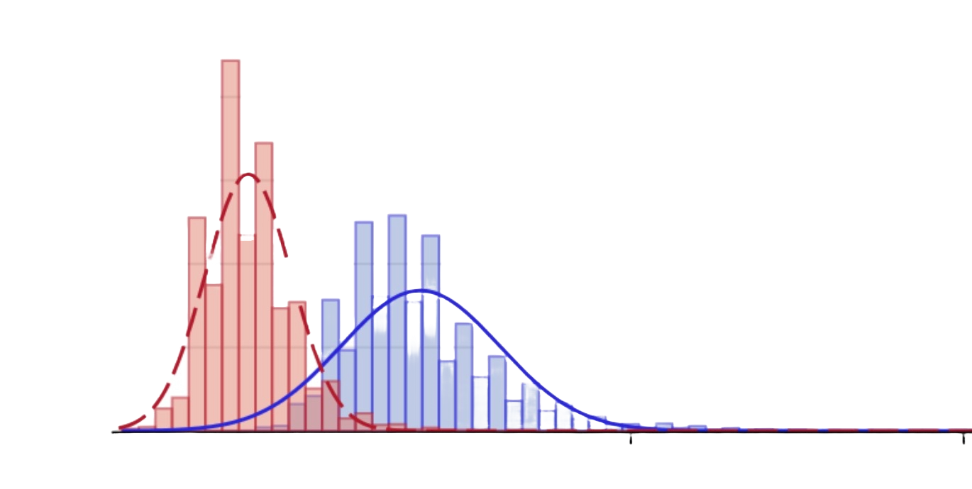
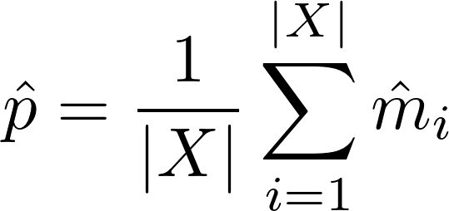
How to infer the dataset usage proportion?
Aggregation of membership guesses over individual data?
1
0
1
1
...
0
1
1
0
=> Bad Idea
...
Unavoidable Error in Membership Guesses
Notes:
- So we know the problem and why it matters — but how do we infer the usage proportion?
- The first idea that probably comes to mind is to guess each point’s membership (e.g., using MIA) and just aggregate.
But as we’ll see, this turns out to be a bad idea, because membership predictions always carry some unavoidable error due to randomness in the training algorithm.
the proportion $p(\mathbf{m}) = \frac{1}{|X|}\sum_{i=1}^{|X|} m_i $ is a value that varies across trials due to the randomness in the sampling process. The best we can do is to construct a reliable estimator that is accurate (in expectation) across random trials

Slide 14
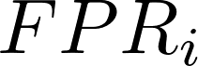
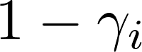
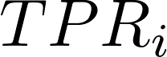
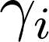
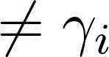
How to infer the dataset usage proportion?
Aggregation of membership guesses over individual data?
=> Bad Idea
in most regimes
Notes:
- In other words, each guess is noisy: when we predict a point to be a member, it could come from either a False positive or a True positive case. — but what we really care about is counting only the true members (that is the probability of x_i being a true member, gamma_i), and these two are unequal in most regimes.
- So when we naively aggregate these predictions, the result is biased

Slide 15
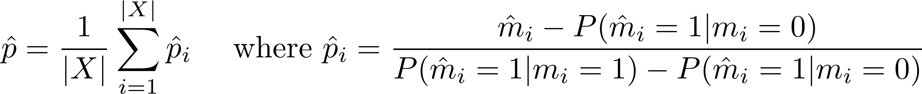
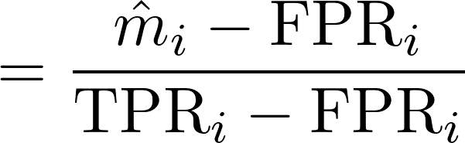
How to infer the dataset usage proportion?
Notes:
To isolate the actual membership from the noisy guesses, we debias each prediction (by reordering the previous formula). This gives us a new estimator.

Slide 16
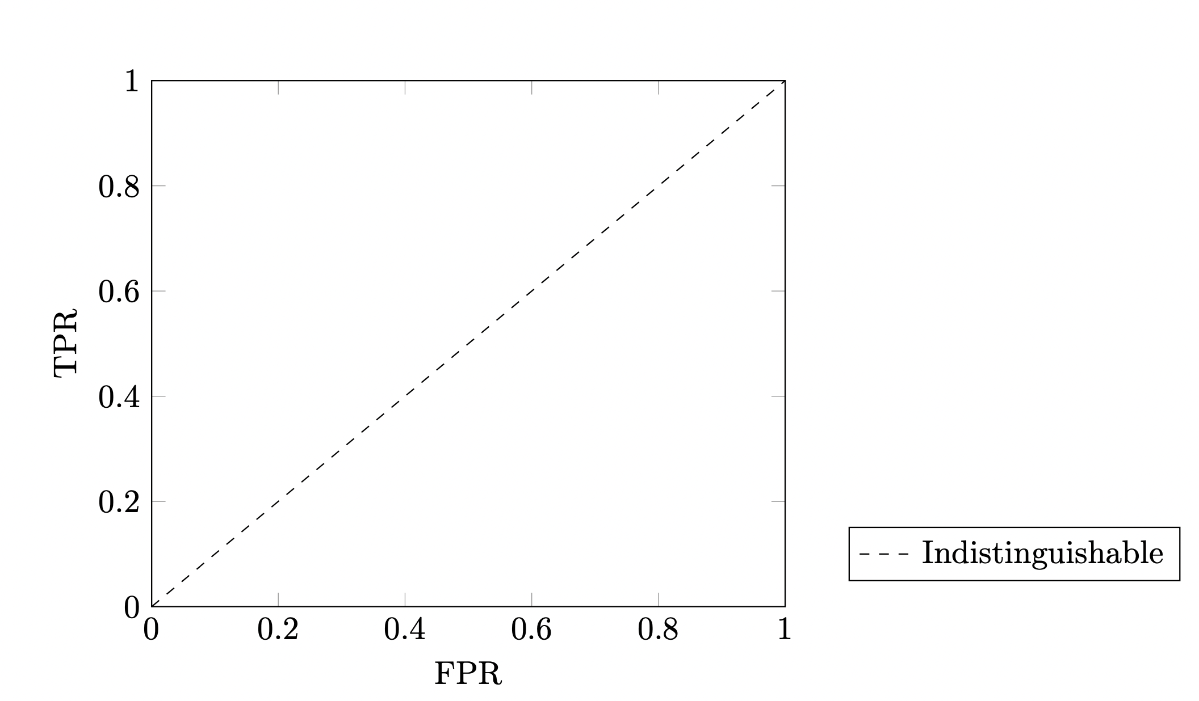
What TPR and FPR should we select?
1. Shadow training: Train $N$ reference models using $X$ (can reuse the model for launching MIA)
An attack strategy
Notes:
The next question is: how do we estimate these errors?
For sure, we can estimate the ROC curve by shadow training, that is using reference models trained on the target dataset to simulate the behavior of target model— which, by the way, could reuse the same models used for launching MIAs.

Slide 17
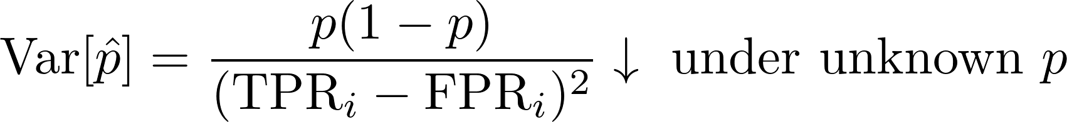
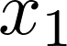
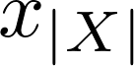
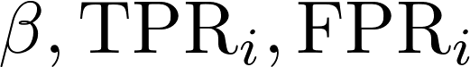
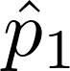
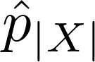
What TPR and FPR should we select?
1. Shadow training: Train $N$ reference models using $X$ (can reuse the model for launching MIA)
2. Choose the attack that maximizes $TPR−FPR$ to minimize:
A single attack
...
...
FPR-TPR tradeoff curve
...
Notes:
- But even if we can approximate the ROC, each attack has TPR/FPR trade-off. (e.g., MIA using different threshold) Which ones should we use to debias?
- Here, we choose the TPR and FPR at the attack that maximizes utility (TPR minus FPR) since this minimizes the variance of our estimator (p hat).
- Then, the full process is: we apply this attack to predict membership for each record, estimate the corresponding TPR and FPR on reference models with the same attack, debias each guess, and then aggregate.

Slide 18
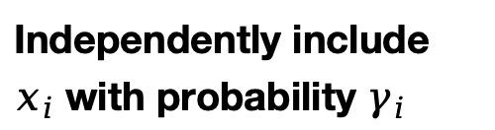
How accurate is our estimator?
If
Independently include $x_{i}$ with probability $γ_{i}$
, $\hat{p}$ is an unbiased estimator of the expected $p$
Uniform sampling
Sampling without replacement
Weighted sampling by data values
Weighted sampling by clusters
...
Notes:
Alright, so the last question in this presnetation: how good is our new estimator?
- We can prove that if each record in the target dataset is independently included with some probability \(\gamma_i\), then our estimator p hat is unbiased for the expected inclusion proportion.
- What does this mean? It means, for most of the common scenarios like uniform sampling, sampling without replacement, or sampling based on data values or clusters, our estimator is quite good.
- What if the sampling is NOT independent? That makes things extremely challenging because as inspectors, we have no way of knowing what kinds of correlations might exist in how the data was used. But, as we’ll see later, empirically, even under practical correlated sampling — like contiguous sampling — our method still works well.

Slide 19
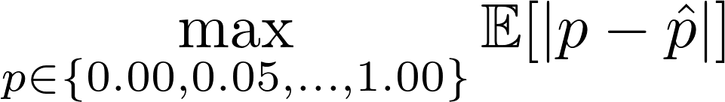
Results for sampling without replacement
Notes:
Just to briefly illustrate the effectiveness of our method — under image classification tasks with sampling without replacement and using maximum mean absolute error as the metrics,

Slide 20
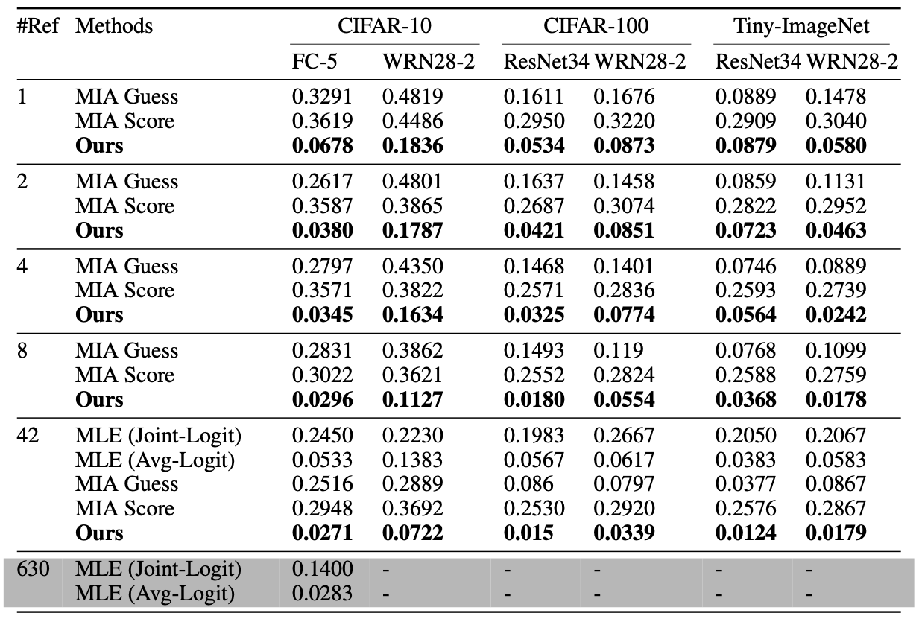
Results for sampling without replacement
More Efficient
< 0.1 Max MAE with just one reference model
Notes:
Just to briefly illustrate the effectiveness of our method — under image classification tasks with sampling without replacement and using maximum mean absolute error as the metrics, we achieve less than 0.1 maximum error across all proportions, even when using just one reference model.

Slide 21
Results for sampling without replacement
1
0
1
1
...
0
1
1
0
...
More Efficient
2x to 4x smaller error than naive MIA aggregation
Naive Aggregation of MIA
Notes:
Compared with the naive MIA-based aggregation methods, that’s about 2 to 4 times smaller in most cases.

Slide 22
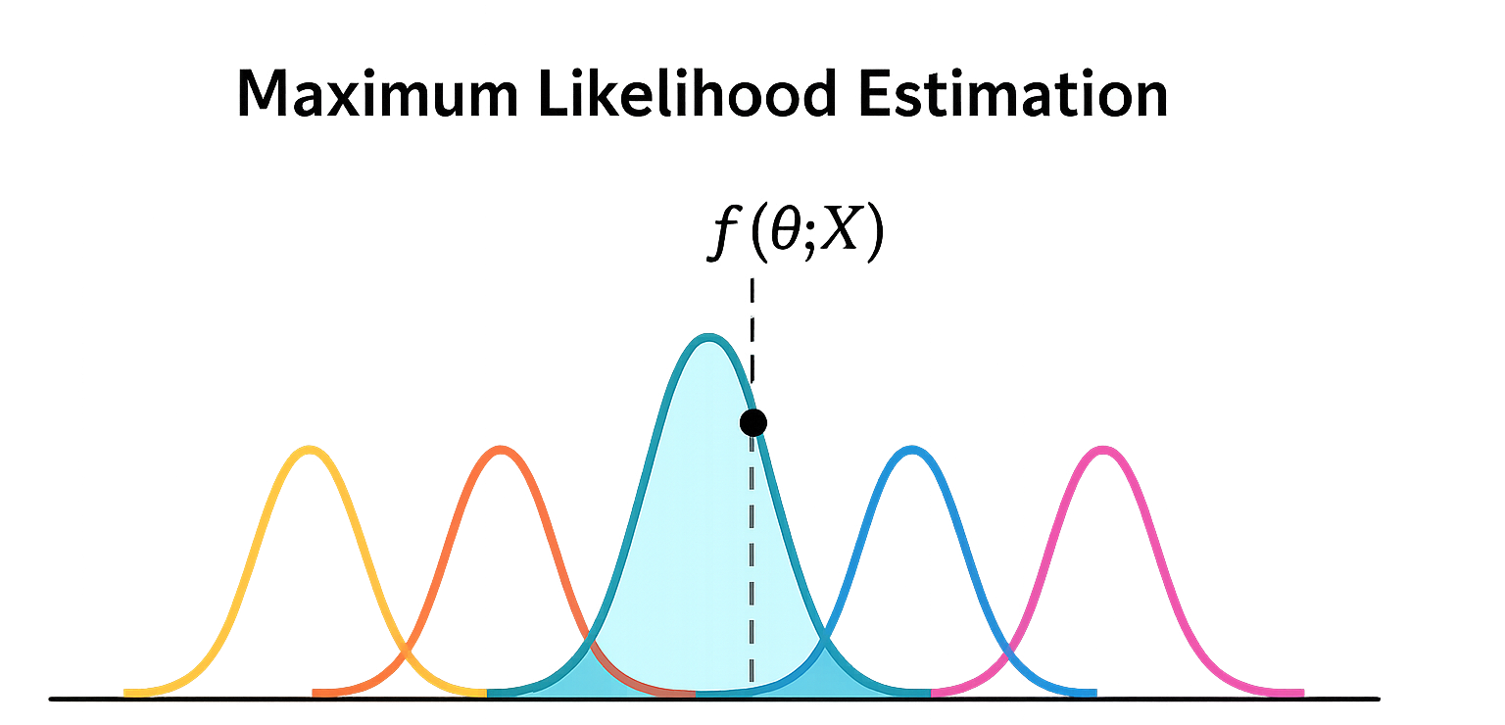




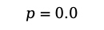
Results for sampling without replacement
More Efficient
Not affordable for larger models (630 refs)
$$p=0.0$$
$$p=0.25$$
$$p=0.5$$
$$p=0.75$$
$$p=1.0$$
Notes:
We also compare against MLE-based baselines. MLE estimates the p by comparing the target model's output [pause] to the distribution of outputs [pause] from models trained on different proportions, and picking the most likely one. These serve as idealized baselines when given extra information of the candidate proportions, sampling strategy, and enough reference models to accurately estimate the distributions.

Slide 23
Results for sampling without replacement
Comparable performance with 80x to 300x less compute
More Efficient
$$p=0.0$$
$$p=0.25$$
$$p=0.5$$
$$p=0.75$$
$$p=1.0$$
Notes:
Even though the MLE baseline uses extra information that our method doesn’t use , our method achieves comparable performance while requiring 80 to 300 times less compute.

Slide 24
Results for sampling without replacement
1
0
1
1
...
0
1
1
0
...
More Efficient
$$p=0.0$$
$$p=0.25$$
$$p=0.5$$
$$p=0.75$$
$$p=1.0$$
Notes:
To summarize, our method is way better than all other baselines under all scenarios

Slide 25
Case study of quantifying book copyright infringement
Notes:
- We also conducted a case study on quantifying book copyright infringement — to demonstrate that 1) our method applies to text data and language models, and 2) more importantly, to show its effectiveness under practical, correlated sampling.

Slide 26
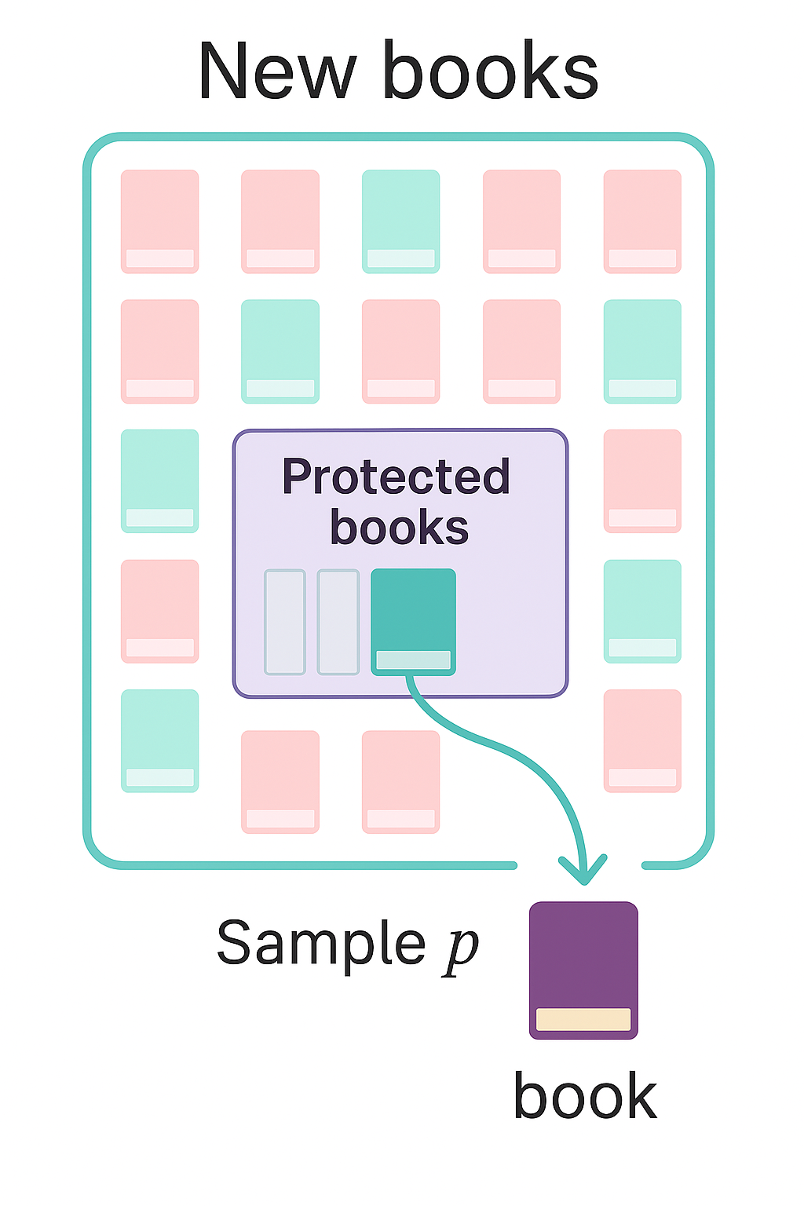
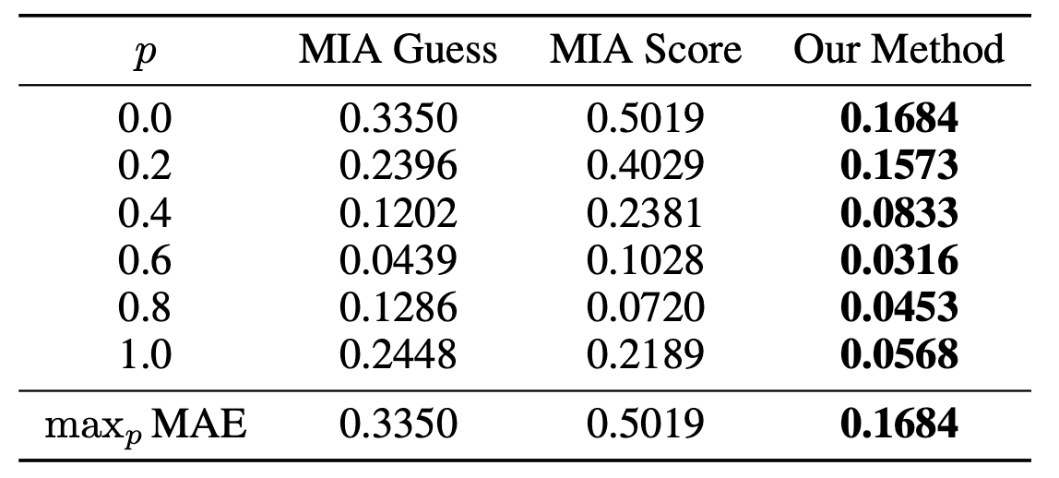
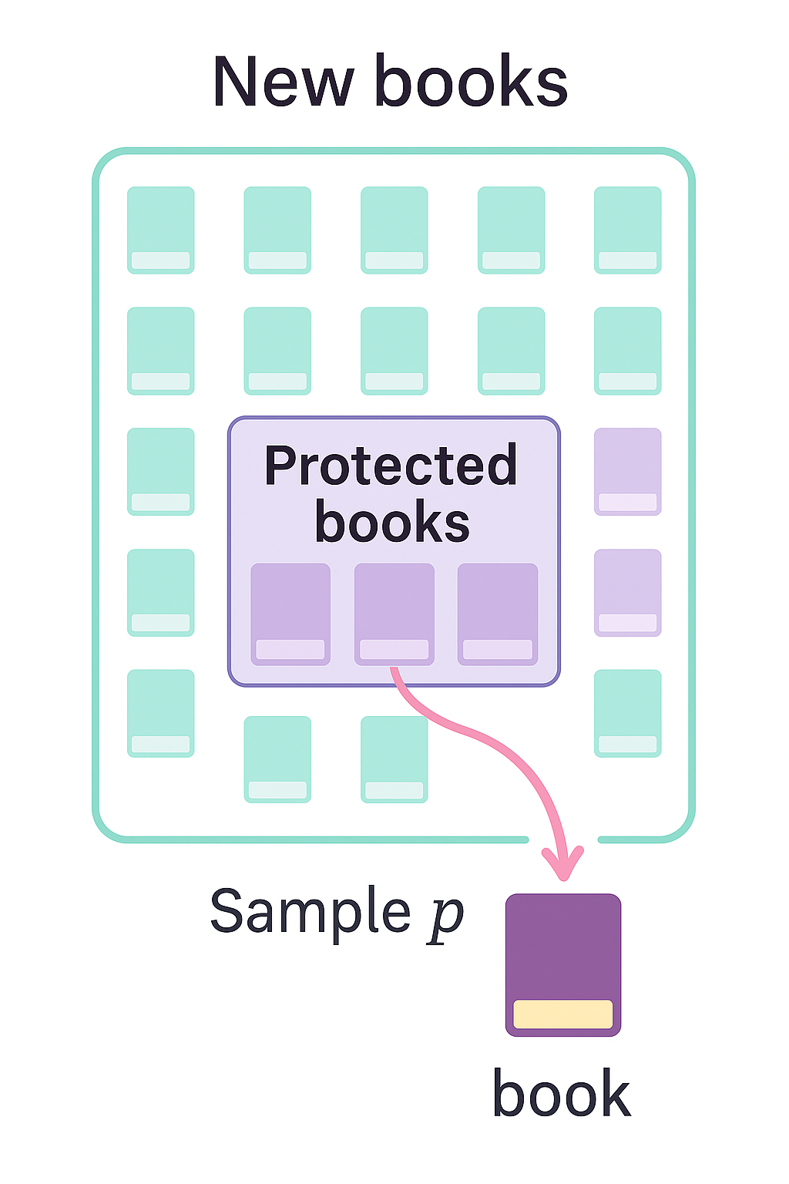
Case study of quantifying book copyright infringement
Only use new books from the BookMIA dataset (Shi et al., 2023)
See our paper for results with other sampling strategies, e.g., EL2N (Paul et al., 2021) for coreset selection
as a contiguous segment from protected books
Notes:
- We only use 50 new books from the BookMIA dataset, all of which are first editioned from 2023 and were not seen by our model (GPT-2). We split them into protected books and population pool to ensure that there is no clear distributional shift between members and non-members caused by the publication date.
- We evaluate varying degrees of data usage, where each time a proportion of text is sampled as a contiguous segment from the protected books.
- We can see that, although the task is much more challenging, our method still performs best — and significantly outperforms all other baselines.

Slide 27
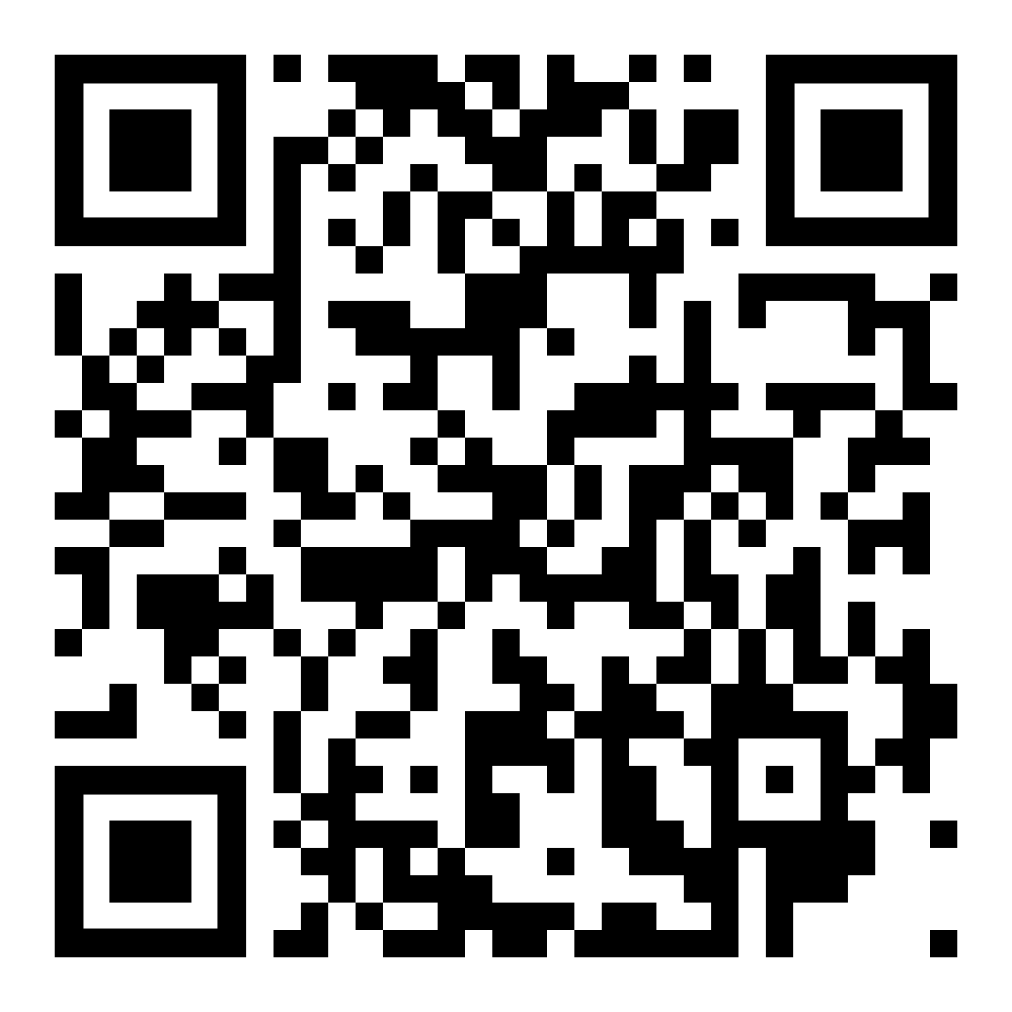

And there’s more!
Poster Session
Many other interesting results in the paper
Properties of the dataset usage inference problem
More efficient debiasing methods
Uncertainty quantification for DUCI
Toward better debiasing by leveraging correlation
Factors influencing DUCI effectiveness
April 26 (Sat) 15:00 — 17:30
Hall 3 + Hall 2B #473
Come explore more at our poster session!
Move beyond binary:
DUCI delivers fine-grained, practical dataset usage proportion estimates.
🛠️ DUCI is in Privacy Meter Toolkit!
Notes:
Scan the QR code to try DUCI in Privacy Meter! Thanks and I’m happy to take any question

Slide 28
References
Maini, P., Yaghini, M., & Papernot, N. (2021). Dataset inference: Ownership resolution in machine learning. ICLR.
Song, C., & Shmatikov, V. (2019). Auditing data provenance in text-generation models. KDD.
Wei, C., Wang, Y., Gao, K., Shao, S., Li, Y., Wang, Z., & Qin, Z. (2025). PointNCBW: Towards dataset ownership verification for point clouds via negative clean-label backdoor watermark. TIFS.
Li, Y., Zhu, M., Yang, X., Jiang, Y., Wei, T., & Xia, S.-T. (2023). Black-box dataset ownership verification via backdoor watermarking. TIFS.
Shi, W., Ajith, A., Xia, M., Huang, Y., Liu, D., Blevins, T., Chen, D., & Zettlemoyer, L. (2024). Detecting pretraining data from large language models. ICLR.

Slide 29
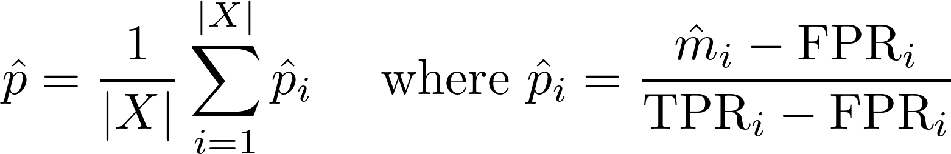
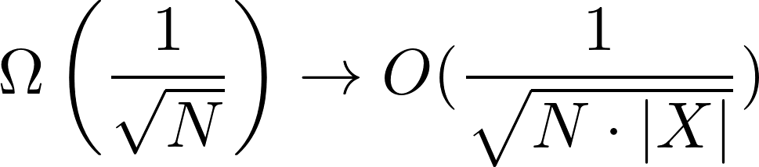
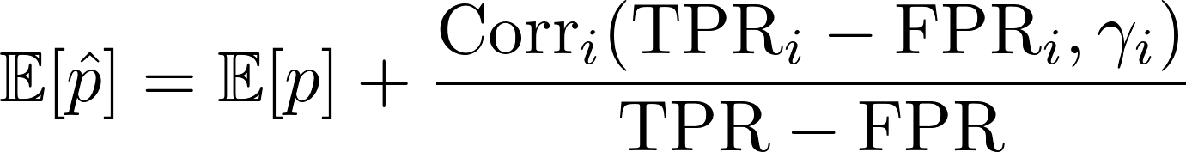
How accurate and efficient is our estimator?
Reduce sampling error of order
Unbiased whenever error term = 0:
①
Dataset-level debiasing: when $γ_{1}=γ_{2}=...=γ_{|X|}$
②
Group-level debiasing (grouping by ${TPR}_{i}−{FPR}_{i}$): when $γ_{1}≠γ_{2}≠...≠γ_{|X|}$
Notes:
But there’s a catch. While our estimator is unbiased, it’s not always efficient AND accurate.
Because we estimate TPR and FPR for each individual record, which introduces a sampling error of order 1 over square root of N, where \(N\) is the number of reference models.
So if we only use, say, a single reference model, the error can be quite large.
To fix this, we propose estimating and debiasing over groups of samples instead of individually.
This reduces the sampling error by a factor that scales with the dataset size — and importantly, unbiased as long as the error term here is zero.
That is, we can have accurate dataset-level debiasing for many practical sampling methods — like sampling without replacement or i.i.d. Poisson sampling.
And group-level debiasing for more structured sampling

